Slide 1
Introduction to 7-1-7
Promoting early and effective action to contain outbreaks with the 7-1-7 target
Date of presentation

Slide 2
What if every outbreak was used as an opportunity to learn and improve?

Slide 3




7-1-7: a systems-based approach to improve speed of outbreak detection, notification, and response
Assess timeliness
Identify bottlenecks
Take action
Notes:
7-1-7 is focused on how to improve the speed of outbreak detection, notification, and response by improving at the system level. This basically involves assessing timeliness, identifying bottlenecks that led to delays, and taking action.

Slide 4
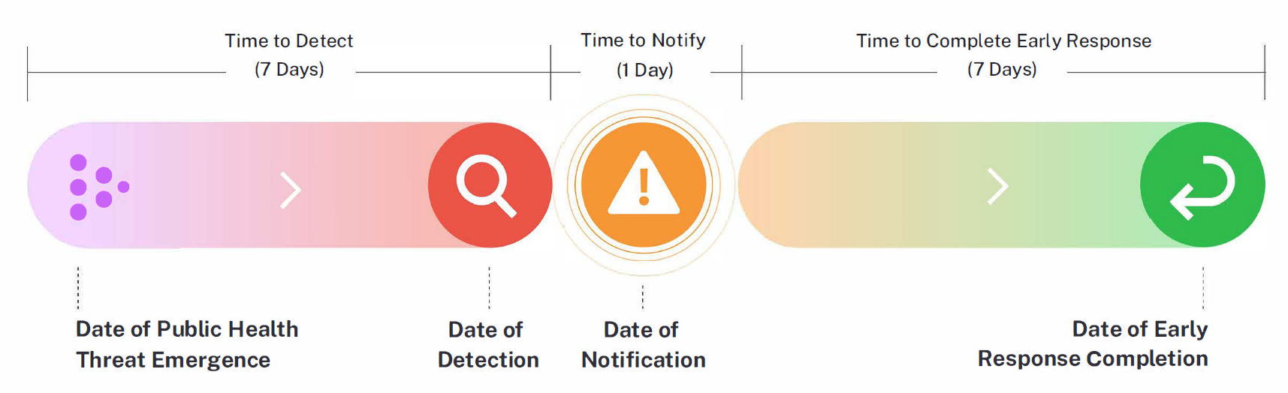
7-1-7 timeliness metrics and milestones
Notes:
A simple set of timeliness metrics, with corresponding targets, can help jurisdictions to identify bottlenecks and propose actions to address those bottlenecks, improving pandemic preparedness
The 7-1-7 approach includes three timeliness metrics and targets:
1. Time to Detect: 7 days to identify a suspected public health threat (time between emergence of a public health threat and detection)
2. Time to Notify: 1 day to inform the appropriate public health authorities (time between detection and notification)
3. Time to Complete Early Response: 7 days to initiate an effective response (time between notification and early response completion)

Slide 5
7-1-7 early response actions
Initiate investigation or deploy investigation/response team
Conduct epidemiologic analysis and initial risk assessment
Obtain laboratory confirmation of the outbreak etiology
Initiate appropriate case management and infection prevention and control (IPC) measures in health facilities
Initiate appropriate public health countermeasures in affected communities
Initiate appropriate risk communication and community engagement activities
Establish a coordination mechanism

Slide 6
How can the 7-1-7 approach improve outbreak response?
Performance improvement
Bottlenecks are easily identified, and short and longer-term actions drive rapid, continuous improvement with every outbreak.
Advocacy
Clear data based on simple metrics informs prioritization and shows need for resources and policy interventions.
Evaluating performance against simple metrics simplifies monitoring and improves transparency in reporting, making it easier to demonstrate the impact of interventions.
Accountability

Slide 7
Adopting and using the 7-1-7 target

Slide 8
Notes:
This graphic shows the 7-1-7 lifecycle – the required steps for effective implementation of the 7-1-7 target.

Slide 9






Key components of 7-1-7 adoption
Situate within the public health system
Map stakeholders + existing systems
Engage stakeholders
Integrate into workflows
Train staff
Pilot use
Notes:
Essential to making 7-1-7 effective and sustainable is integrating it into existing workflows and engaging key stakeholders both during adoption and use of 7-1-7.

Slide 10
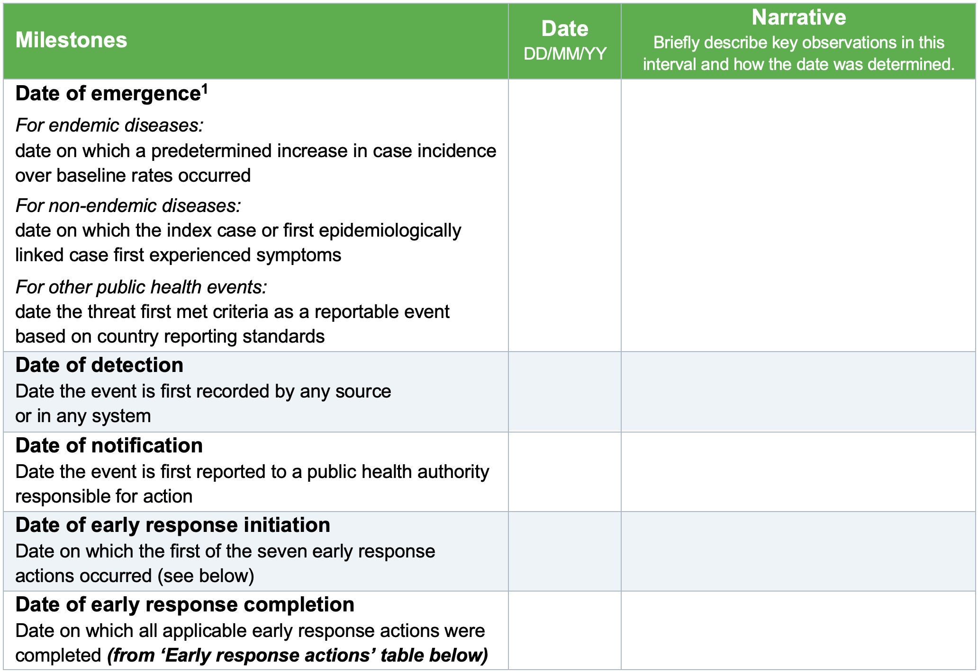
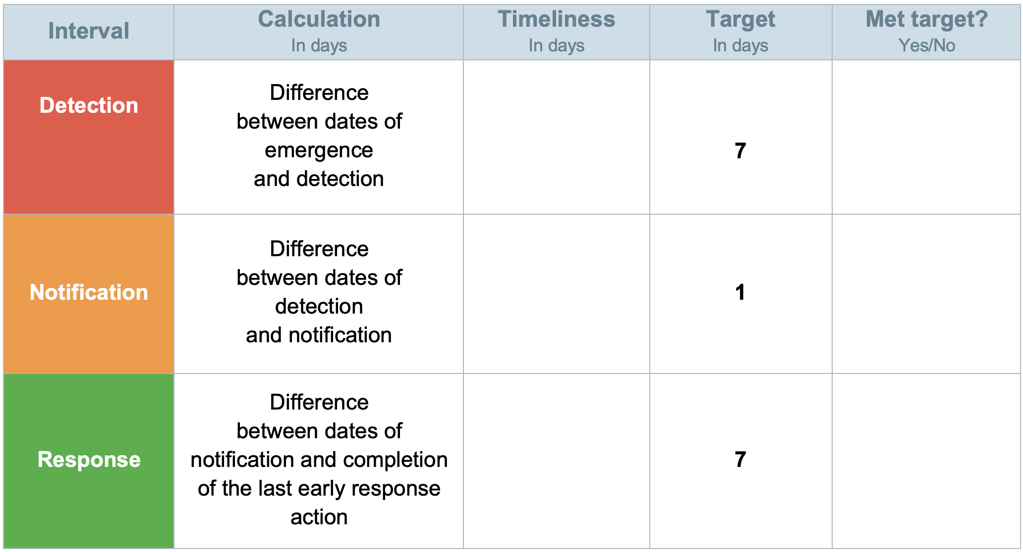
Key steps for using the 7-1-7 target
For each event, document key dates and narratives and assess if the full target was met
7-1-7 Assessment Tool

Slide 11
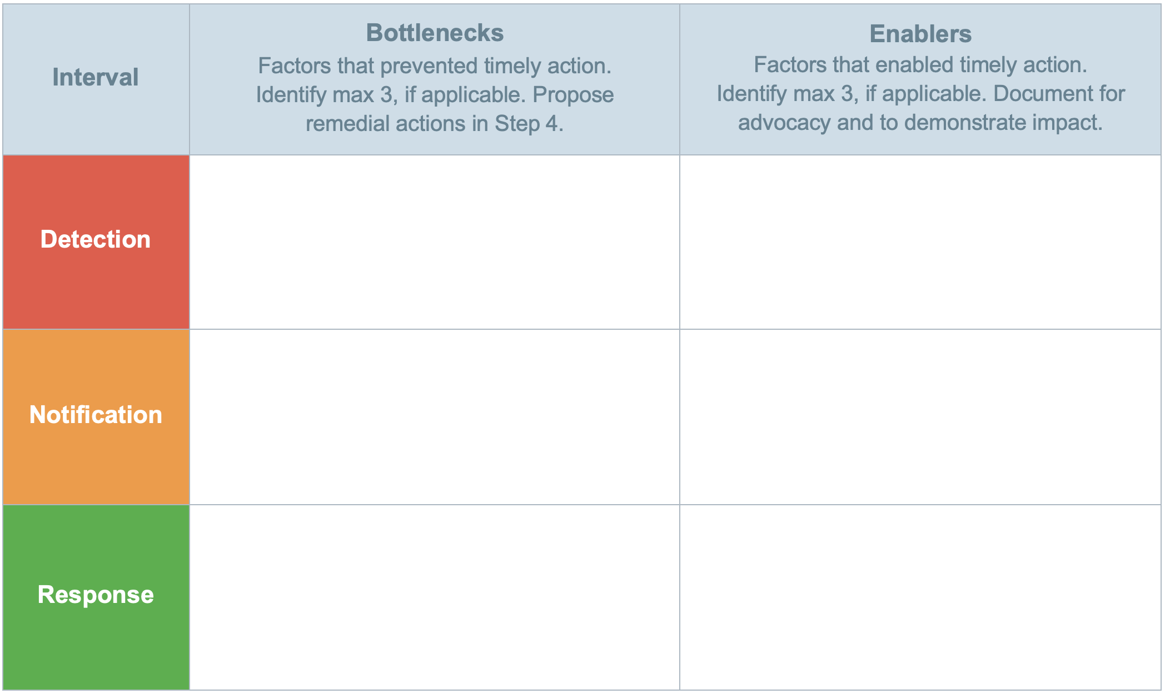
Getting to the root causes of bottlenecks is critical for identifying the specific systems or processes that require strengthening
7-1-7 Assessment Tool

Slide 12
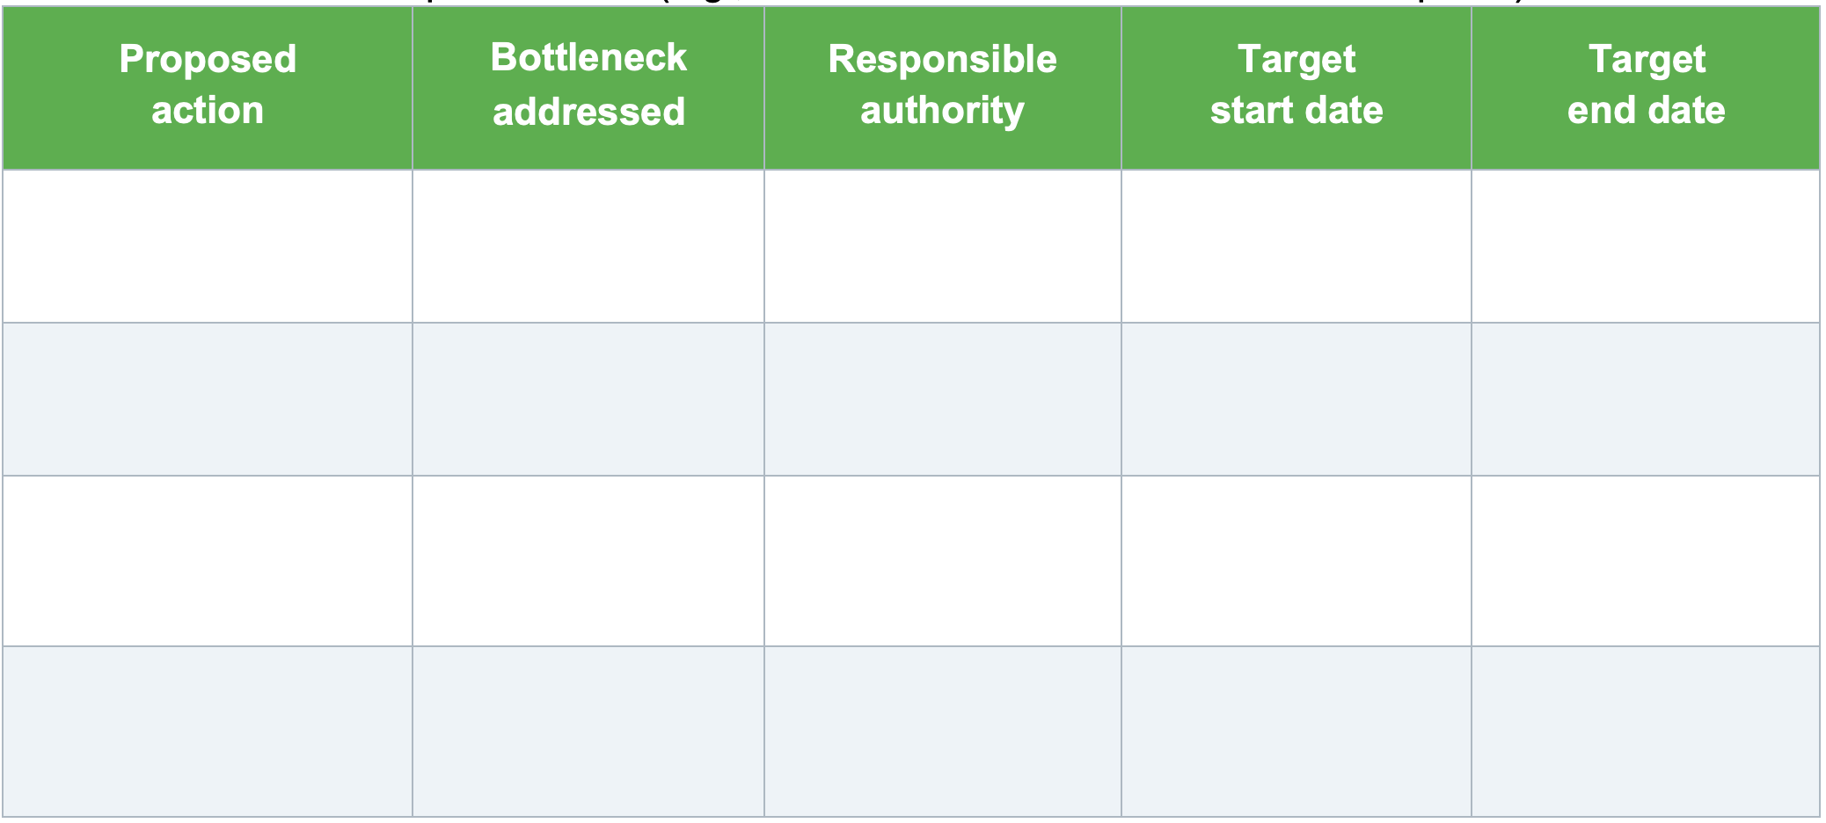
Some actions can be done immediately, others may require longer-term planning and investment
7-1-7 Assessment Tool

Slide 13
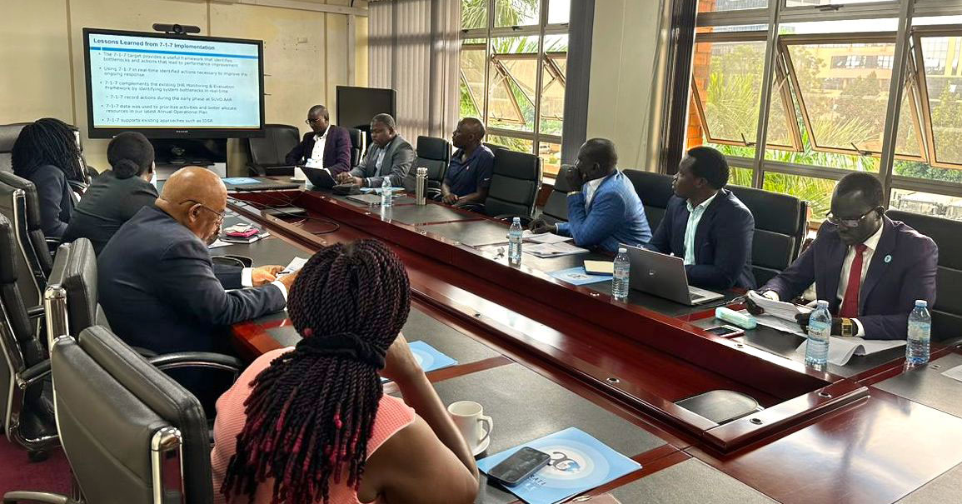
Engage stakeholders and discuss bottlenecks, enablers, and corrective actions for each outbreak and consolidated data across outbreaks

Slide 14
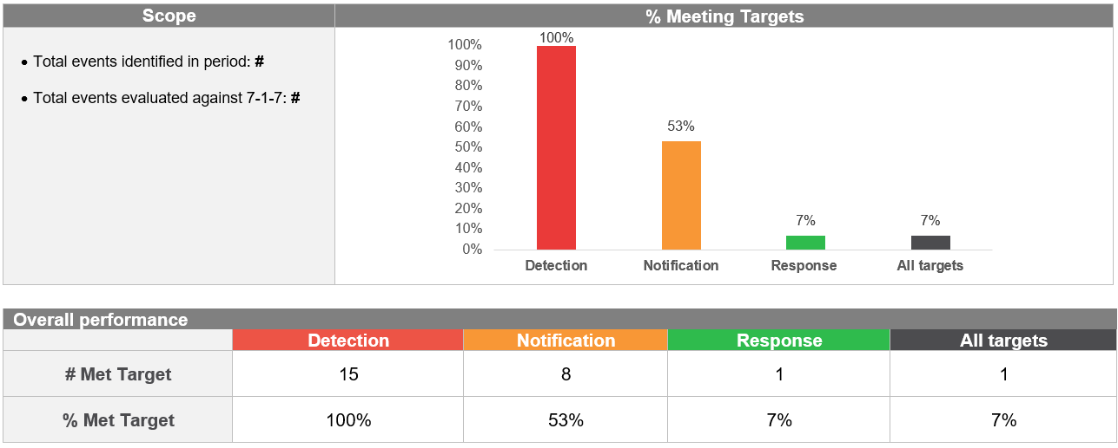
Before each operational planning cycle, synthesize learnings from 7-1-7 and use them to prioritize activities for financing, along with other evaluations (SPAR, JEE, AAR, etc.)
7-1-7 Synthesis Report

Slide 15
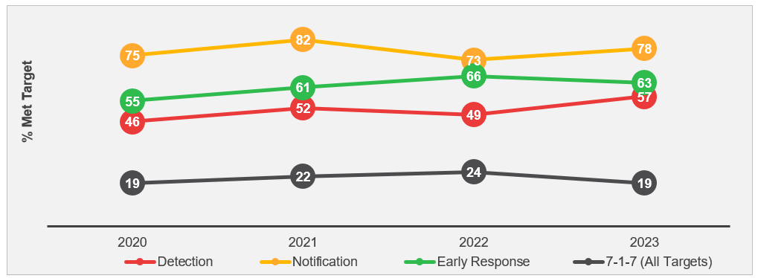
Translate 7-1-7 findings into advocacy asks and raise awareness of needed investments or policy changes, build confidence that investments will result in measurable impacts
7-1-7 Synthesis Report

Slide 16
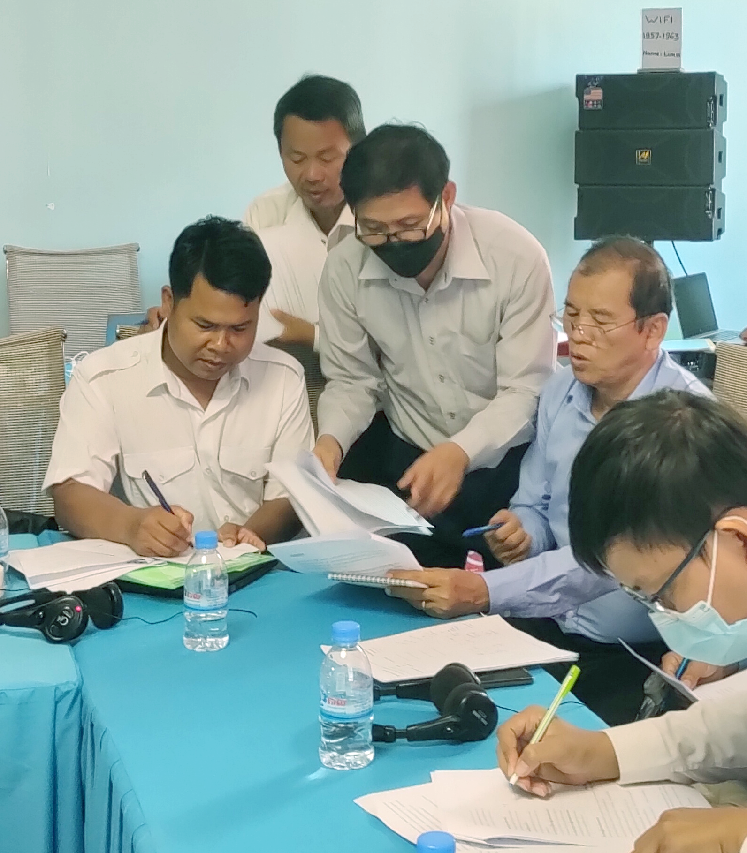
Core principles for effective use of 7-1-7
Use 7-1-7 often for continuous performance improvement.
7-1-7 is intended as a learning opportunity and works best with non-punitive, honest, transparent assessment.
Each 7-1-7 interval – detection, notification, and early response – is essential.
The earlier you use 7-1-7, the better your chance of calibrating outbreak response.
7-1-7 flexibly integrates into existing systems and workflows; planning; and frameworks.
Engage a broad set of stakeholders because 7-1-7 focuses on addressing a wide range of systemic bottlenecks.

Slide 17
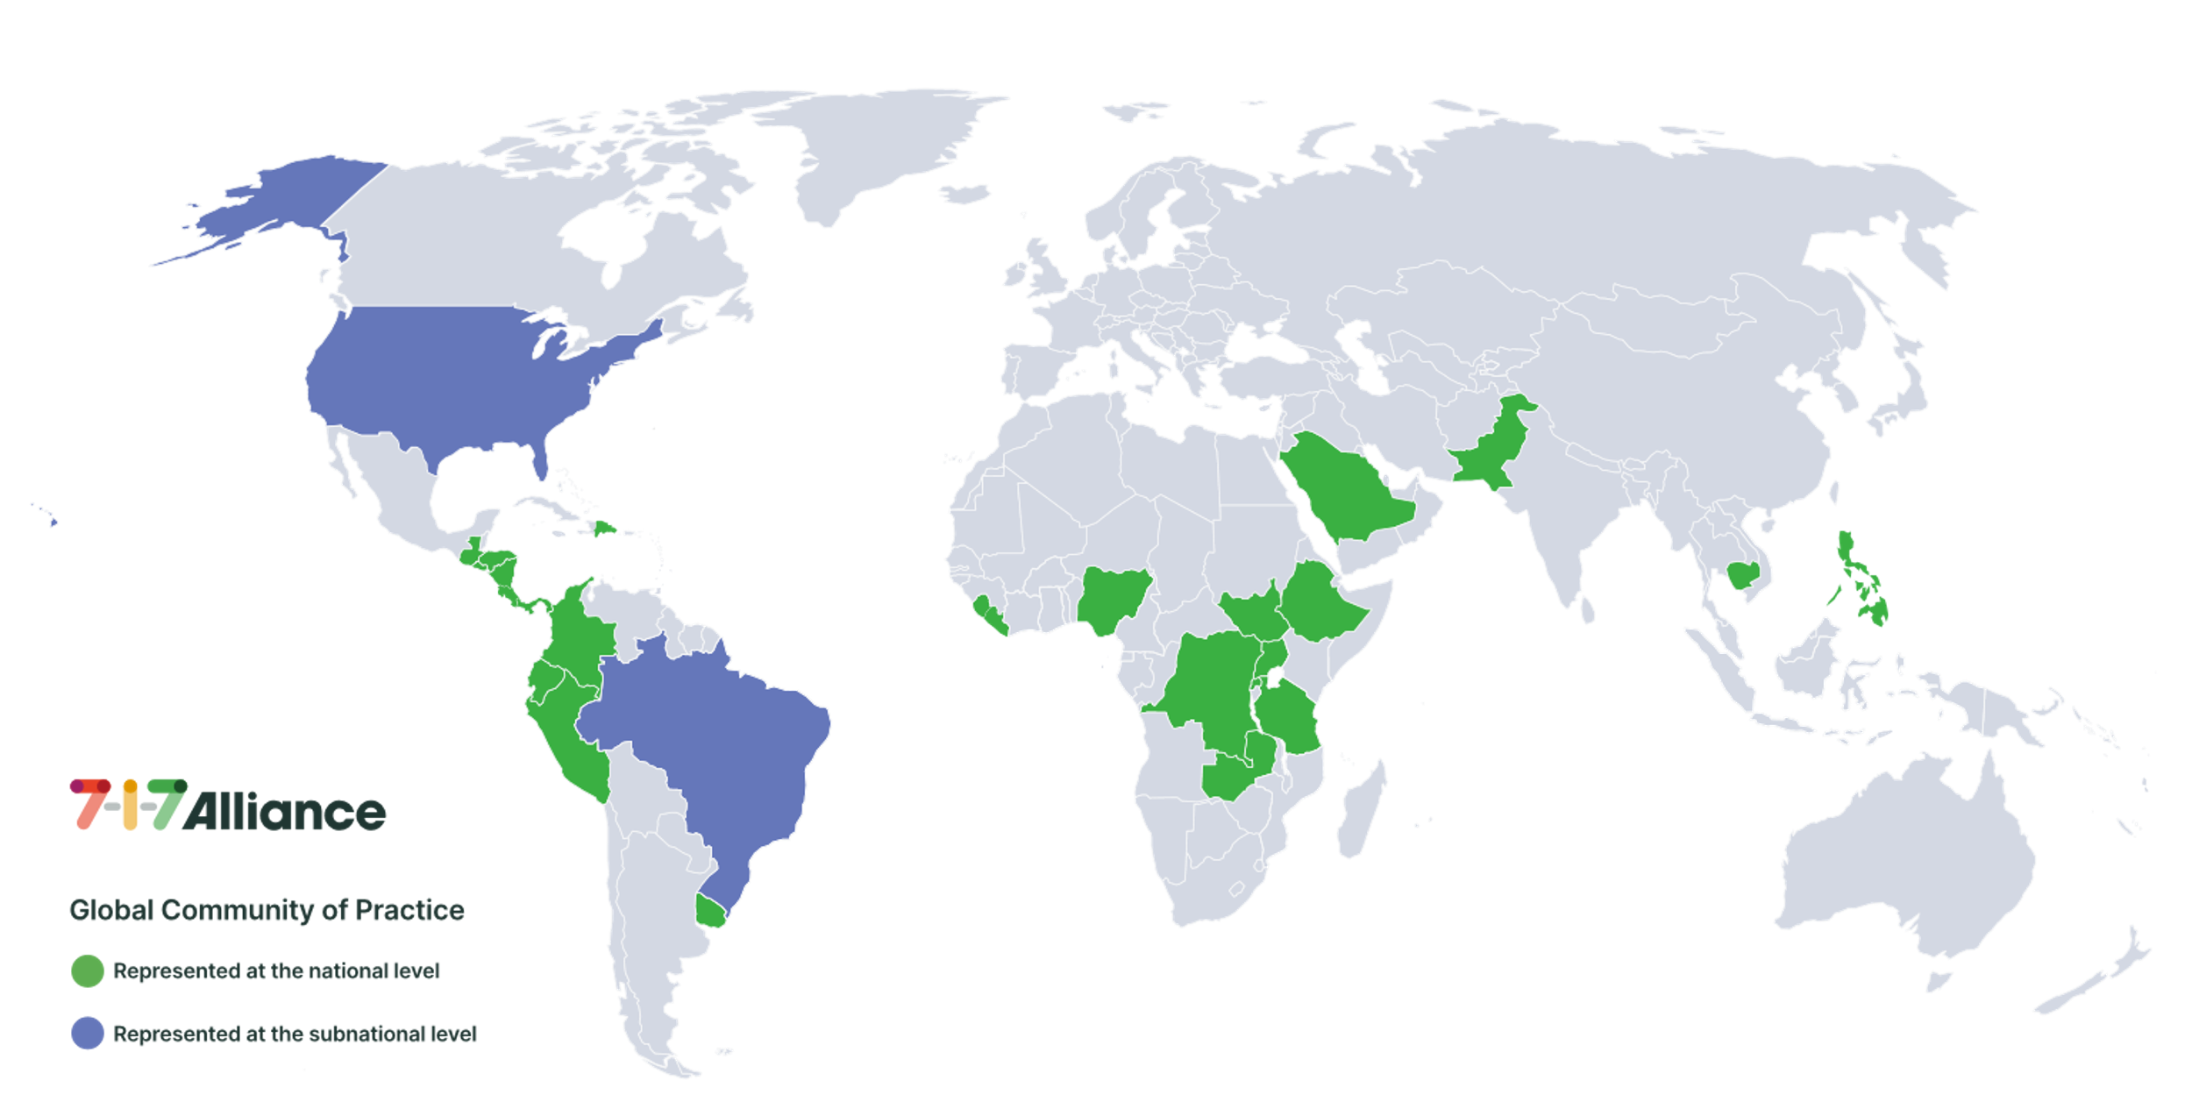
Country implementation
7-1-7 Global Community of Practice (December 2024)
Piloted in Uganda, Nigeria, Ethiopia, Sierra Leone, Rwanda, Liberia, Brazil and the United States of America
Over 20 countries are now using 7-1-7, including in Africa, the Americas, Southeast Asia and the Pacific.

Slide 18

Lessons learned
Reaching 7-1-7 is feasible for most outbreaks
Having a champion is critical to support
high-level buy-in and implementation
Surveillance and response actors must
work together to achieve 7-1-7
Several key bottlenecks can be fixed
at little to no cost

Slide 19





Global reach
WHO Global Program of Work (GPW14): Includes 7-1-7 as a joint outcome indicator.
WHO Early Action Reviews: Incorporate 7-1-7 methodology and tools for rapid improvements in outbreak detection and response.
US Global Health Security Strategy: Highlights 7-1-7 bottleneck analyses as a key method for monitoring and evaluating progress towards building GHS capacity.
Pandemic Fund: Incorporated 7-1-7 in the results framework with two indicators under Element 1.
Other World Bank Multiphase Programmatic Approach grants also incorporate 7-1-7.
Global Fund: Includes 7-1-7 in its M&E framework.
Notes:
The 7-1-7 Alliance has a variety of training packages for member countries and partners, including packages for sensitization, implementers, and training of trainers
We also have recommended and sample agendas available based on learning from trainings we and countries in the alliance have delivered.

Slide 20
7-1-7 Alliance
What we do and how we can help

Slide 21

What the 7-1-7 Alliance does
Provides and facilitates technical assistance and training
Offers small country grants
Engages partners in communities of
practice and regional learning networks
Develops resources and hosts an online hub with guidance, tools, training materials and discussion groups
Generates new evidence through operational research
Notes:
The 7-1-7 Alliance Secretariat is hosted by Resolve to Save Lives and chaired by a Technical Steering Group made up of country representatives and partners.

Slide 22
Training materials
7-1-7 Alliance-supported training materials
Training packages
Sensitization package
Implementers’ package
Training of trainer package
Leadership package (coming soon)
  Training packages are built from adaptable modules of presentations and activities
Introduction to 7-1-7 talk
Simex (materials + facilitator training)
Core principles talk/activity
Using 7-1-7 talks + activities
Adopting 7-1-7 talks + activities
Training of trainers talks + activities
Own outbreak analysis activity
Case studies
Country experience talks
…
Notes:
The 7-1-7 Alliance has a variety of training packages for member countries and partners, including packages for sensitization, implementers, and training of trainers.
We also have recommended and sample agendas available based on learning from trainings we and countries in the alliance have delivered.

Slide 23

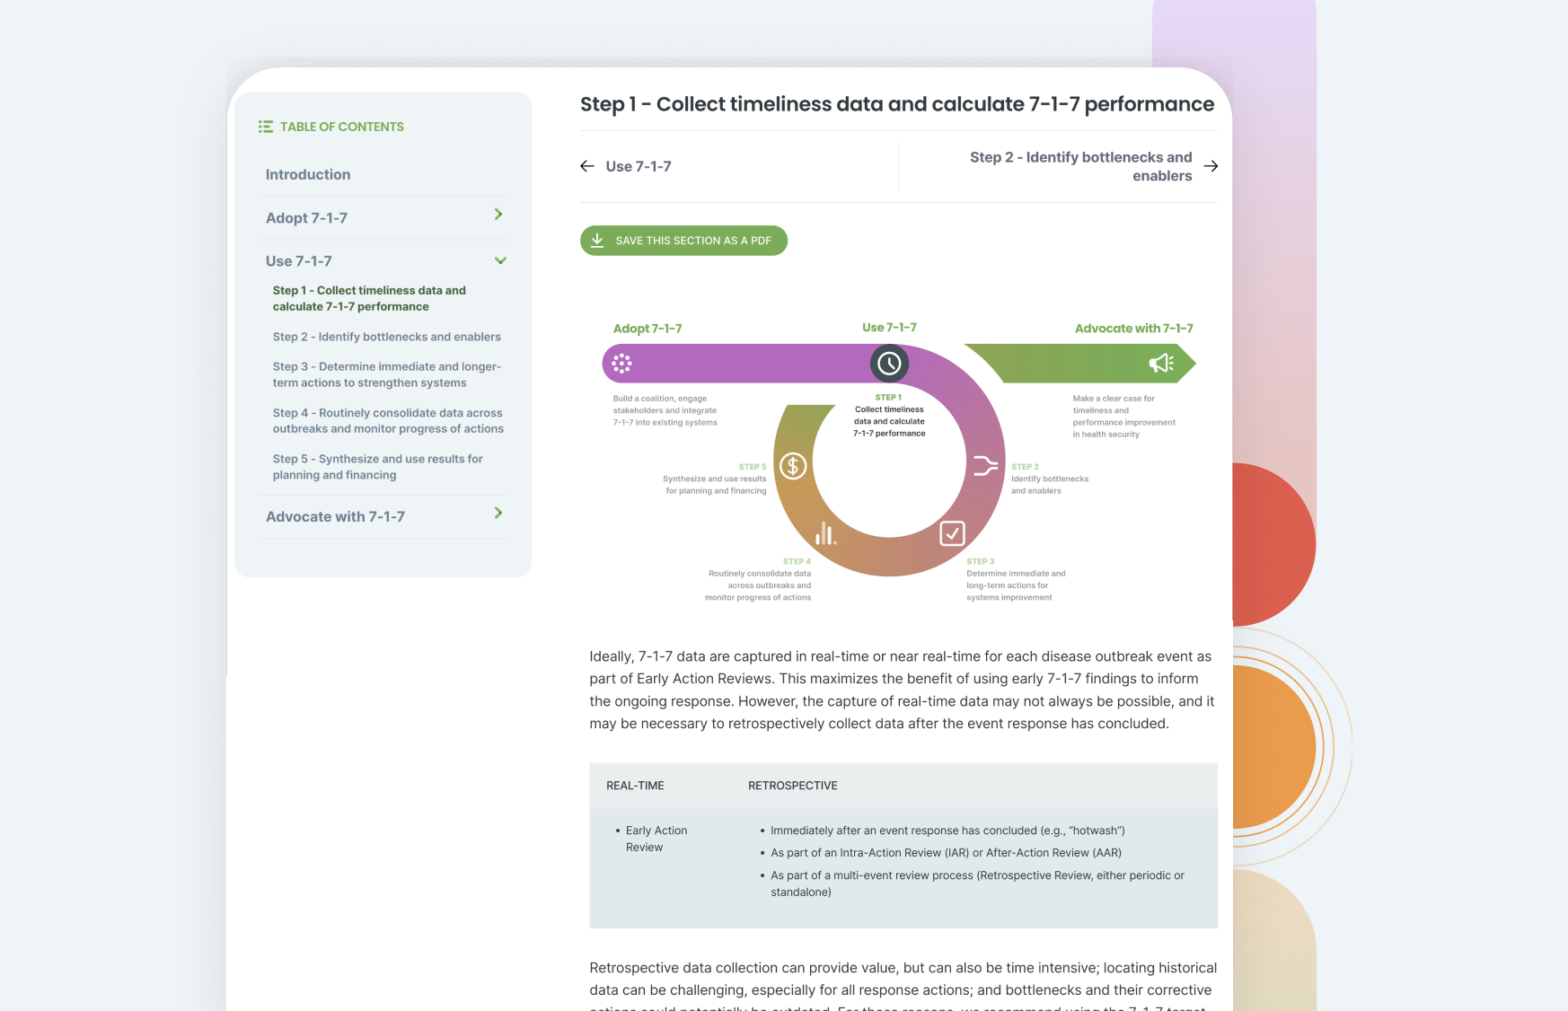
Our resources
Resources to support implementation are
available at
717alliance.org
Quick links:
Get started here
7-1-7 online toolkit
Advocacy briefs for decision-makers
FAQ

Slide 24

Join the Alliance
To become a partner of the Alliance and access technical support
Email the Alliance Secretariat
contact@717alliance.orgto get started
To stay up-to-date on news and opportunities
Subscribe
to the Alliance news and join our Global Learning Network
Notes:
Subscribe to the 7-1-7 Alliance news https://717alliance.org/#subscribe

Slide 25



Join the 7-1-7 Global Community of Practice
The 7-1-7 Alliance hosts a global Community of Practice to accelerate learning and implementation success
Designed for technical teams using 7-1-7
Regular community engagements with country spotlights​
Exclusive resources and platforms
Notes:
Complete a request form to join the COP: https://forms.office.com/r/tcGyChMrwb?origin=lprLink

Slide 26
Thank you

Slide 27
Supplemental slides
7-1-7 milestone definitions

Slide 28
Date of emergence
For endemic diseases: date on which a predetermined increase in case incidence over baseline rates occurred
For other public health events: date the threat first met criteria as a reportable event based on country reporting standards
For non-endemic diseases: date on which the index case or first epidemiologically linked case first experienced symptoms

Slide 29
Date of detection
Date the event is first recorded by any source or in any system
Detection can occur in a community setting, at a health care facility, at a laboratory, or by a surveillance system

Slide 30
Date of notification
Date the event is first reported to a public health authority responsible for action
Public health authority can be at any level (e.g., municipal, district, state, region or federal) if they are responsible for action

Slide 31
Date of early response completion
Date on which all applicable early response actions were completed
7-1-7 early response actions
Initiate investigation or deploy investigation/response team
Conduct epidemiologic analysis and initial risk assessment
Obtain laboratory confirmation of the outbreak etiology
Initiate appropriate case management and infection prevention and control (IPC) measures in health facilities
Initiate appropriate public health countermeasures in affected communities
Initiate appropriate risk communication and community engagement activities
Establish a coordination mechanism

